Slide 1

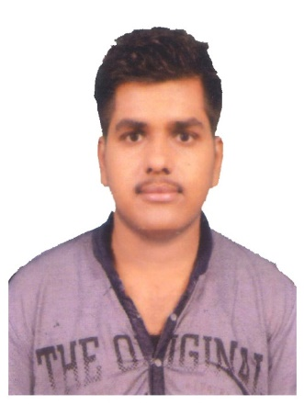





Ayush Agrawal
Education and certificates
Bachelor of Technology Computer Science : 2017 - 2021
Analyst/Software Engineer
Skills Spring Boot Spring MVC
JPA CRUD/JPA MONGODB
Bootstrap Semantic ui
Base Location: ^{Mumbai}
Email ID:
Ayush.Agrawal@capgemini.com
_{Mobile No:} +91 8770835055
Grade:
A4
Backend
Spring Boot/Spring Security MongoDB
REST-API
NodeJS
Strengths
A self driven learner with Front-End and Back-End knowledge. Passionate about implementing and launching new projects.
Ready to learn new technologies/Frameworks and implement them to further improve my knowledge.
A team player with good communication skill always ready to work for the enrichment of knowledge.
Has working knowledge on Angular and Java Microservice Development using Spring framework on an intermediate level.
Achivement
Flight Booking System Application
Completed end to end case study of Flight Booking System System along with JWT authentication, Swagger and Billing System using Spring boot Microservices with Eureka Server. Semantic UI and Angular used for user interface.
Database
SQL database – MySQL
No SQL database – MongoDB
Coded and designed Static Web Pages
Web Technologies
HTML5 CSS3 SASS
Javascript/TypeScript
Developed website with HTML5 and CSS3 Along Frameworks like SASS(Syntactically awesome style sheets) to make website more interactive and dynamic.
Developed an full stack android application using Flutter
AddOns Github Maven Postman
Also Implemented Eureka Server and Semantic UI in case study and upskilling day by day.
Completed
Additional Details
Excellent Communication Skills
Team Player
Check out my work on GitHub & Video Profile
Presentation Title | Author | Date © Capgemini 2017. All rights reserved | 1

